Slide 1
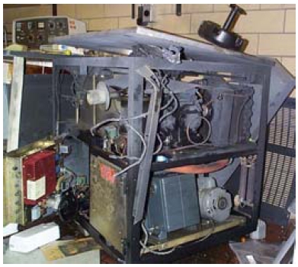
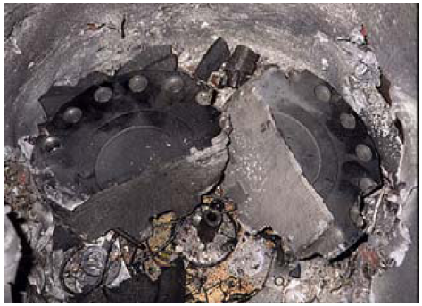
Centrifuge Use Safety
From: http://www.hawaii.edu/ehso/jabsom/Centrifuge%20Safety%20SOP.pdf

Slide 2
Centrifuge Use Safety
2
http://www.hawaii.edu/ehso/jabsom/Centrifuge%20Safety%20SOP.pdf

Slide 3
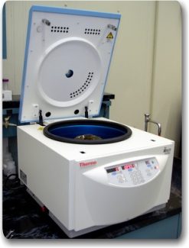
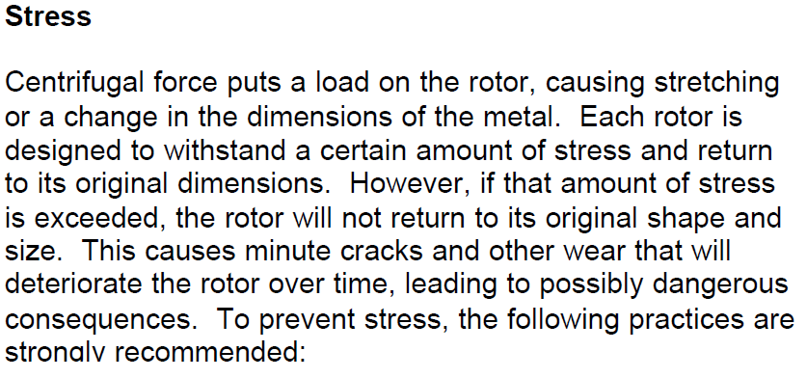
Centrifuge Use Safety
3
http://www.uos.harvard.edu/ehs/ih/centrifuge.pdf

Slide 4
Centrifuge Use Safety
4
http://www.uos.harvard.edu/ehs/ih/centrifuge.pdf

Slide 5
Centrifuge Use Safety
5
http://www.uos.harvard.edu/ehs/ih/centrifuge.pdf

Slide 6
Centrifuge Use Safety
6
http://www.uos.harvard.edu/ehs/ih/centrifuge.pdf

